Slide 1
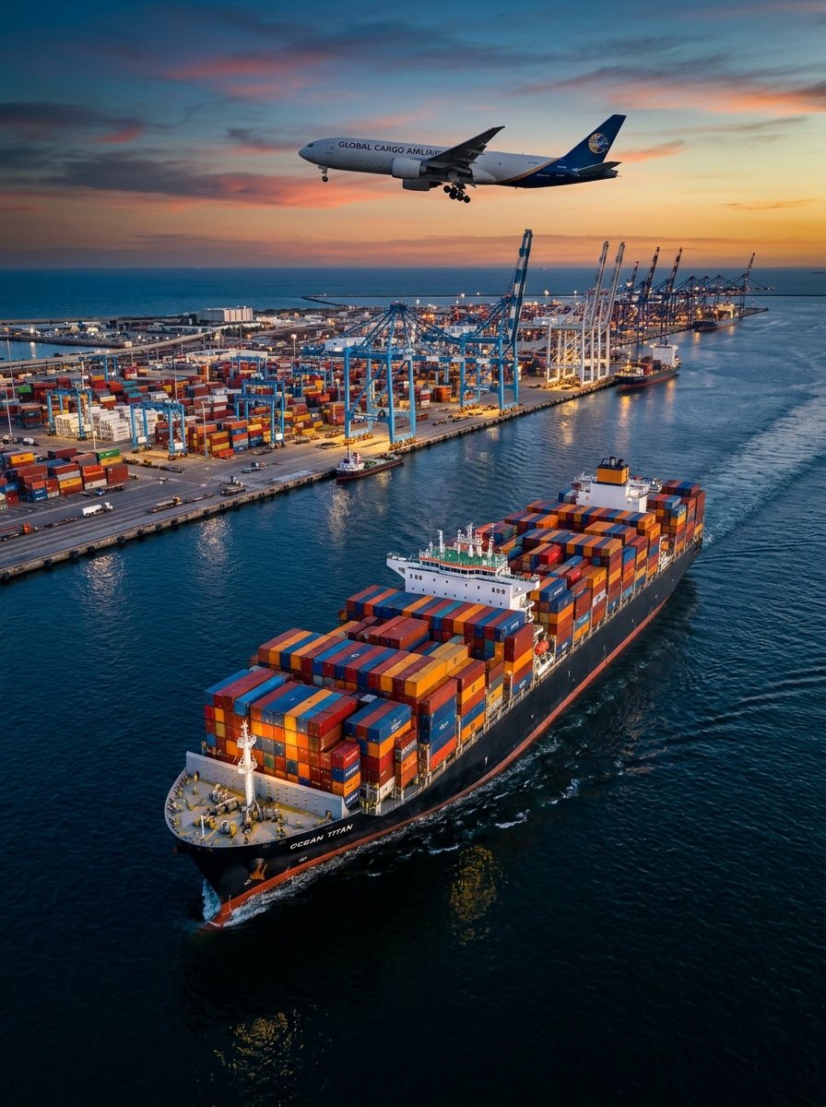

PORT OF COLOMBO // LKCMB
COMPANY PROFILE • 2026
SPILLBURG LOGISTICS 1
(PRIVATE) LIMITED
MOVING CARGO. CONNECTING BUSINESSES.
A licensed international Freight Forwarder, Customs House Agent, and Multimodal Logistics Service Provider headquartered in Colombo, Sri Lanka—delivering economical, secure, and time-critical export and import cargo solutions across the globe.
[01 // SUPPORT]
[02 // CUSTODY]
[03 // LICENSED]
[04 // SCHEDULE]
CONTACT 24H
PACKAGE SECURITY
FULL PERMISSIONS
DELIVERY ON TIME
Dedicated operations & customer support desk ready round-the-clock.
All export, import & bonded goods handled with extreme care and CCTV.
Required statutory authority & ASYCUDA customs permissions in Sri Lanka.
Precision vessel, flight & haulage scheduling for punctual door delivery.
HQ: Office 14, Basement Level, Cinnamon Lakeside Hotel, Colombo 02 | www.spillburglogistics1.com | +94 11 233 6116

Slide 2
SEC-01 // CORPORATE OVERVIEW
MOVING CARGO. CONNECTING BUSINESSES.
WHO WE ARE • INTERNATIONAL TRANSPORT & CLEARING SPECIALISTS
ABOUT SPILLBURG LOGISTICS 1
Spillburg Logistics 1 (Private) Limited is a premier Logistic Service Provider and licensed clearing agent with a team of seasoned experts providing international transport solutions for customers around the globe. Headquartered in Colombo, we deliver reliable cargo handling services for both export and import consignments at Sri Lanka Customs.
Ensuring that cargo arrives at the right place and at the right time involves real skill—we ensure moving goods globally is executed economically and efficiently.
FAST & PROFESSIONAL EXECUTION
CUSTOMIZED SUPPLY SOLUTIONS
Moving finished products, raw materials, and industrial equipment worldwide requires specialized operational expertise across ocean, air, and road networks.
Every mandate starts with a complete assessment of your business needs—engineering tailored routing, consolidation, and customs clearance workflows.
OUR VISION
OUR MISSION
“To be the preferred transportation and total logistics solutions provider for our customers across domestic and international trade lanes.”
“To provide total logistics solutions that gain the confidence and trust of our valued clients by conducting business with complete integrity.”
WHY CHOOSE SPILLBURG LOGISTICS 1 • FIVE COMMITMENTS
01 // SUPPORT
02 // FRICTIONLESS
03 // BESPOKE
04 // NETWORK
05 // DISCIPLINE
100% Customer Support
Ease & Convenience
Customer Oriented
Wide Global Coverage
Professional & Efficient
SPILLBURG LOGISTICS 1 (PVT) LTD // WWW.SPILLBURGLOGISTICS1.COM
PAGE 02

Slide 3
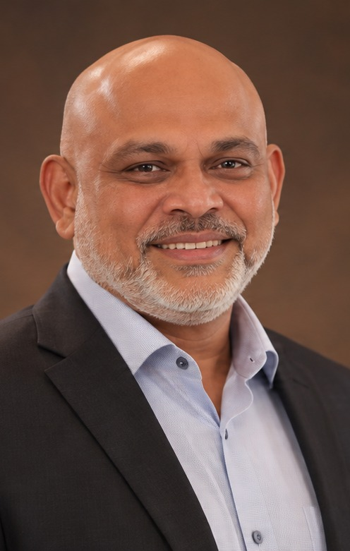
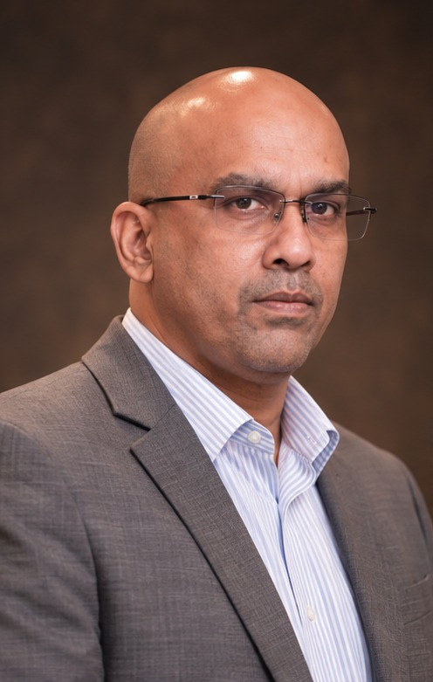
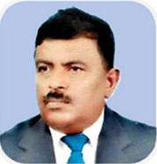
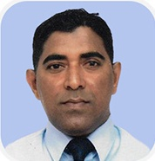
SEC-02 // LEADERSHIP & GOVERNANCE
MOVING CARGO. CONNECTING BUSINESSES.
BOARD OF DIRECTORS & SENIOR OPERATIONS LEADERSHIP
MANAGEMENT TEAM
Mr. M H K M Hameez
Shaameel Mohideen
MANAGING DIRECTOR
DIRECTOR
BSc. (Hons) University of London, CPM (London), CPA (Australia)
MABE (UK), MBA (Aus), CMA (Aus)
Former Director attached to the Investment Promotions division of the Board of Investment (BOI) of Sri Lanka, with over 15 years of hands-on experience setting up projects and providing project management services. Seasoned adviser and expert in Trade Agreements such as SAFTA, ISLFTA, and SLPFTA.
Former banker attached to the Trade and Finance divisions of HSBC and Standard Chartered Bank, bringing over 15 years of senior experience in international trade finance, Letters of Credit (LC), project financing, project management, and project structuring.
Mr. M. I. Razik
Mr. Mafaz Azeez
DIRECTOR
SENIOR MANAGER
Attorney-at-Law (SL), Commissioner of Oaths & Notary Public
21+ Years in Maritime Port, Cruise & Freight Operations
Attorney-at-Law, Notary Public, and Senior Consultant with over 30 years of experience across commercial and corporate law, M&A, business structuring, customs and maritime legal compliance, and legal advisory.
Over 21 years of hands-on operational experience in transport, tourism, and port logistics, including passenger (Pax) and baggage exchange operations for international passenger cruise lines calling at Sri Lankan ports alongside air, sea, and land freight coordination.
SPILLBURG LOGISTICS 1 (PVT) LTD // WWW.SPILLBURGLOGISTICS1.COM
PAGE 03

Slide 4
SEC-03 // MULTIMODAL TRANSPORT (I)
MOVING CARGO. CONNECTING BUSINESSES.
FROM DOCUMENTS TO BULK GOODS • GLOBAL FORWARDING
SEA, AIR & LAND FREIGHT
[MOD-01] SEA FREIGHT FORWARDING (FCL & LCL)
Flexible ocean freight solutions for shipping large volumes of containerized and bulk cargo across global trade lanes.
• Full Container Load (FCL 20' / 40' / 40'HC) & LCL Consolidation
• Export & Import Port-to-Port and Door-to-Door Execution
• Project Shipping (Breakbulk, Ro-Ro, Flat Rack & Open Top)
• Reefer Containers, MCC Transshipment & Marine Cargo Insurance
[MOD-02] AIR FREIGHT & EXPRESS CARGO COORDINATION
Robust global air freight network centered at Bandaranaike International Airport (CMB) for time-critical shipments.
• Import & Export Air Consolidation (Belly-Hold & Freighter)
• Door-to-Door Express & Urgent AOG/VOR Spares
• Rapid CMB Airport Customs Clearance & AWB Documentation
• Airport Warehousing, Cold-Room Transfers & IATA DG Handling
[MOD-03] LAND FREIGHT & INLAND ROAD HAULAGE
Fleet capacity to transport and forward all road freight shipments in and out of Sri Lanka with flexible, safe execution.
• Full Truck Load (FTL) & Less-Than-Truck Load (LTL) Haulage
• 20' & 40' Container Deliveries & BOI Zone Port Drayage
• Door-to-Door Domestic & Residential Pick-Up / Delivery
• High-Quality Protective Wrapping & GPS-Monitored Dispatch
SPILLBURG LOGISTICS 1 (PVT) LTD // WWW.SPILLBURGLOGISTICS1.COM
PAGE 04

Slide 5
SEC-04 // MULTIMODAL TRANSPORT (II)
MOVING CARGO. CONNECTING BUSINESSES.
ANCILLARY SHIPPING, STORAGE & BORDER CLEARANCE
WAREHOUSING, CUSTOMS & SPECIAL CARGO
[MOD-04] WAREHOUSING, BONDED STORAGE & COLD ROOM
Accommodating your goods safely until ready to be shipped or collected at destination with commodity-specific storage.
• Picking, Packing, Export Crating, Palletizing & Shrink-Wrapping
• 24-Hour Security & Continuous CCTV Surveillance
• Customs Bonding Warehouse & Bulk/Racked Storage Spaces
• Temperature-Controlled Cold Room Facilities for Perishables
[MOD-05] CUSTOMS BROKERAGE & ASYCUDA CLEARANCE
Authorized Customs Clearing Agent in Sri Lanka delivering frictionless export and import consignment clearance.
• Direct Electronic ASYCUDA World CUSDEC Lodgment & Assessment
• HS Code Tariff Classification & Valuation Advisory
• SAFTA, ISLFTA & SLPFTA Preferential Certificate of Origin Clearance
• BOI Section 17 / TIEP Duty-Free & SLSI/NMRA/Quarantine Permits
[MOD-06] PROJECT CARGO, HEAVY LIFT & CRUISE LOGISTICS
Engineered transport for Out-of-Gauge (OOG) industrial machinery and specialized passenger cruise vessel turnarounds.
• Heavy Lift & OOG (Transformers, Turbines, Boilers & Plant)
• Route Surveys, Low-Bed Modular Trailers & Escort Permits
• Turnkey Passenger (Pax) & Baggage Exchange for Cruise Lines
• Urgent Ship Spares in Transit Clearance & Launch Delivery
SPILLBURG LOGISTICS 1 (PVT) LTD // WWW.SPILLBURGLOGISTICS1.COM
PAGE 05

Slide 6
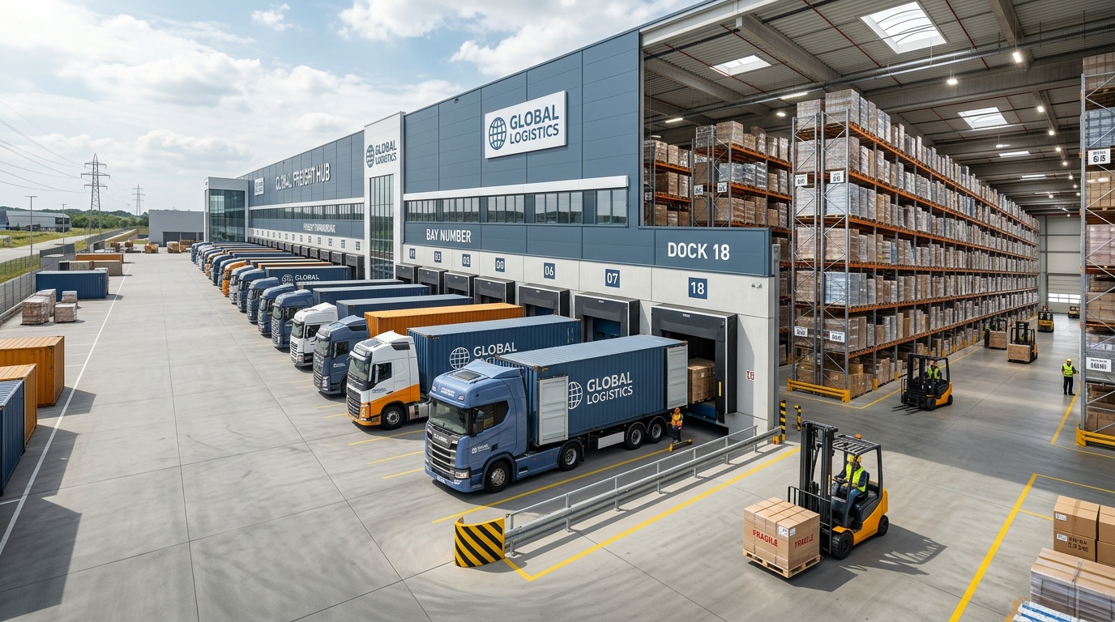
SEC-05 // OPERATIONAL WORKFLOW & SPECS
MOVING CARGO. CONNECTING BUSINESSES.
STANDARDIZED CHAIN-OF-CUSTODY & TECHNICAL MATRIX
OPERATING PROCEDURE & CAPABILITIES
STEP 01
STEP 02
STEP 03
STEP 04
STEP 05
Booking & Space
Documentation
Customs Clear
Transit Track
Final Handover
Carrier routing, rate lock & vessel/flight slot allocation.
Invoice, Packing List, B/L or AWB & CoO verification.
ASYCUDA World CUSDEC filing, tariff & wharf exam.
Proactive vessel/flight milestone & arrival alerts.
DO collection, gate-out, haulage & signed POD.
TECHNICAL SERVICE CAPABILITIES & PARAMETER MATRIX
• SEA FREIGHT FORWARDING (OCEAN FCL/LCL): 20' / 40' / 40'HC Dry, Reefer, Open Top, Flat Rack | Global Port-to-Port & Door-to-Door | Ocean B/L, Sea Waybill, VGM, Manifest
• AIR CARGO COORDINATION (AIR EXPRESS): ULD Pallets, Belly-Hold, Main-Deck Freighter | CMB Airport to Global Hubs | MAWB / HAWB, Dangerous Goods Declaration
• LAND FREIGHT & DRAYAGE (ROAD FTL/LTL): 20'/40' Prime Movers, Covered Box Trucks, Tail-Lift | Island-wide Sri Lanka & BOI Zones | Waybill, Gate Pass, EIR, Signed POD
• CUSTOMS BROKERAGE (BORDER CLEAR): ASYCUDA World, RAMIS, Single Window | Seaport (LKCMB) & Airport (CMB) | CUSDEC, HS Assessment, FTA CoO, BOI
• WAREHOUSING & STORAGE (CFS / BONDED): Racked Dry, Customs Bonded, Cold Room | Colombo Port Access Corridors | Goods Received Note (GRN), Tally Sheet
SPILLBURG LOGISTICS 1 (PVT) LTD // WWW.SPILLBURGLOGISTICS1.COM
PAGE 06

Slide 7
SEC-06 // COLOMBO HUB ADVANTAGE
MOVING CARGO. CONNECTING BUSINESSES.
STRATEGIC INDIAN OCEAN TRANSSHIPMENT & FTA GATEWAY
SRI LANKA MARITIME CROSSROADS
#1 Hub
18m+ Draft
7.2M+ TEUs
24 / 7 / 365
SOUTH ASIA TRANSSHIPMENT
DEEP-WATER ULCV BERTHS
TERMINAL CAPACITY
ASYCUDA CLEARANCE
REGIONAL TRADE AGREEMENT ADVISORY (SAFTA / ISLFTA / SLPFTA):
Led by our Managing Director’s extensive background with the Board of Investment (BOI) and regional trade treaties, we assist exporters and importers in structuring shipments under the Indo-Sri Lanka Free Trade Agreement (ISLFTA), Pakistan-Sri Lanka FTA (SLPFTA), and SAFTA—securing duty concessions and rules-of-origin compliance.
MULTI-COUNTRY CONSOLIDATION (MCC) & ENTREPÔT TRADE:
We coordinate LCL cargo originating from multiple regional ports to be de-stuffed, sorted, relabeled, and consolidated into FCL containers under customs bond in Colombo for onward shipment to Europe, the UK, the Middle East, and North America.
DIRECT TERMINAL & BORDER COVERAGE ACROSS SRI LANKA:
• PORT OF COLOMBO TERMINALS: Direct wharf operations across JCT (Jaya Container Terminal), SAGT (South Asia Gateway Terminals), CICT (Colombo International Container Terminals), and ECT.
• HAMBANTOTA & TRINCOMALEE: Ro-Ro vehicle transshipment, project breakbulk discharge, bulk industrial commodities, and heavy-lift port clearance.
• BIA AIR CARGO & BOI ZONES: Express air cargo clearance at Katunayake (CMB) and direct bonded trucking to Katunayake, Biyagama, Seethawaka, Horana, and Koggala EPZs.
SPILLBURG LOGISTICS 1 (PVT) LTD // WWW.SPILLBURGLOGISTICS1.COM
PAGE 07

Slide 8
SEC-07 // SECTORS & CLIENT ENDORSEMENTS
MOVING CARGO. CONNECTING BUSINESSES.
VERTICAL SUPPLY CHAIN EXPERTISE & PROVEN RELIABILITY
INDUSTRIES SERVED & TESTIMONIALS
01. APPAREL & TEXTILES
02. INDUSTRIAL MACHINERY
03. RETAIL & FMCG
Raw fabric rolls & trims under BOI/TIEP, and Garments-on-Hanger (GOH) & boxed exports to EU, UK & US buyers.
Factory production lines, generators, construction plant & steel structures via Flat Rack, Open Top & low-bed.
High-frequency FCL & consolidated LCL consumer goods, SLSI/NMRA clearance, bonded storage & distribution.
04. AUTOMOTIVE & SPARES
05. PERISHABLES & TEA
06. RENEWABLE ENERGY
Urgent air freight spares for fleet maintenance alongside FCL tyres, batteries, lubricants & components.
Pure Ceylon Tea, spices, coconut products, seafood & fresh produce in pre-cooled Reefers & cold rooms.
Solar PV modules, inverters, battery storage units & substation transformers delivered to project sites.
VERIFIED CLIENT TESTIMONIALS • FROM SPILLBURGLOGISTICS1.COM
“Very good service and I was very impressed with the product delivery and the packaging methods for long-time sea voyage.”
“Most trustable transportation company. All my goods were properly cared for and properly delivered. I am very happy to have worked with this company.”
“One of the best services I had for the first time in my business—very flexible and reliable across every stage of delivery.”
Marks Philip
Kavainda Perera
Tony Johnson
INTERNATIONAL SEA FREIGHT
CARGO & TRANSPORT CLIENT
COMMERCIAL LOGISTICS CLIENT
SPILLBURG LOGISTICS 1 (PVT) LTD // WWW.SPILLBURGLOGISTICS1.COM
PAGE 08

Slide 9

SEC-08 // DISPATCH & FREIGHT DESK
MOVING CARGO. CONNECTING BUSINESSES.
24/7 OPERATIONS DESK • REQUEST A FREIGHT QUOTE
GET IN TOUCH
SPILLBURG LOGISTICS 1 (PRIVATE) LIMITED
HEADQUARTERS ADDRESS:
Office 14, Basement Level, Cinnamon Lakeside Hotel,
No. 115, Sir Chittampalam A. Gardiner Mawatha,
Colombo 02, Sri Lanka.
24H HOTLINES, LANDLINE & FAX:
24h Hotlines: +94 777 487 720 | +94 777 790 919
General Line: +94 11 233 6116 | Fax: +94 11 252 9309
FREIGHT DESK EMAIL & WEB PORTAL:
Email: info@spillburglogistics1.com
Website: www.spillburglogistics1.com
SCAN FOR ONLINE PORTAL
spillburglogistics1.com
AIR FREIGHT • SEA FREIGHT • LAND FREIGHT • WAREHOUSING
“MOVING CARGO. CONNECTING BUSINESSES.”
Economical, Secure & Time-Critical International Transport Solutions
Port of Colombo (LKCMB) | Bandaranaike Int'l Airport (CMB) | Island-Wide BOI Zones
SPILLBURG LOGISTICS 1 (PVT) LTD // WWW.SPILLBURGLOGISTICS1.COM
PAGE 09

